Slide 1










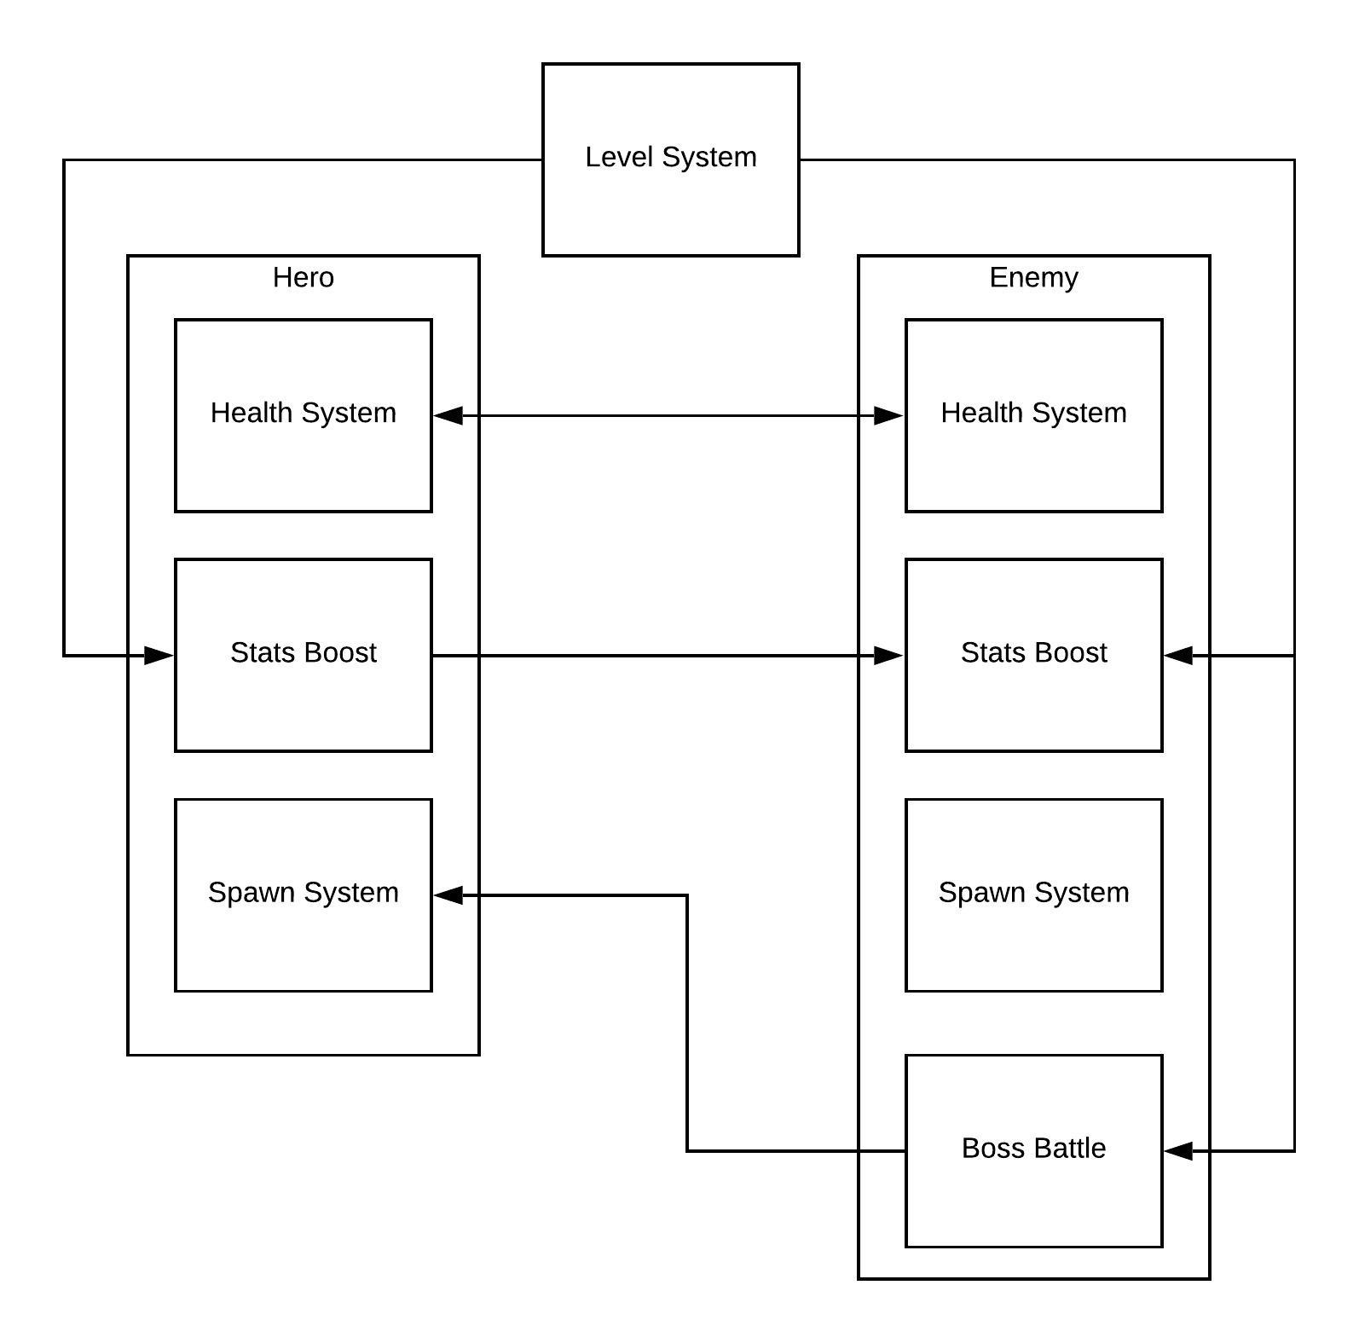

Ultimon Hero Fatmir Gusani
How to Play?
Pick Hero
Battle Enemy
Level Up
Beat Boss
Win Game
More
Info
Summary
I recreated the battling part of the Pokémon games where the player is in a constant One-On-One battle. I created a game that is interesting, challenging & and fair. The goal for my game is simple, make the player enjoy my game.
Level system
Start game at level 1, after every battle the hero gains experience.
Health system
Deal & receive damage from the enemy.
Battle system
Turn-based attacking system, hero and enemy take turns attacking each other.
Spawned
Randomly generated enemy spawn for every battle.
Attack Moves
hero deals damage to the enemy by attacking.
Different Stats
Each starter hero has different stats.
Final Boss
A clone of your hero with better states.
Awards
New look for starter hero.
Technical
Created & Designed in Unity
Coded in C#
Scene Management
Instance & Shared Value
Coroutine & invoke
Start & Awake & Update APIs
Objects

